Slide 1














Java Concept

Slide 2
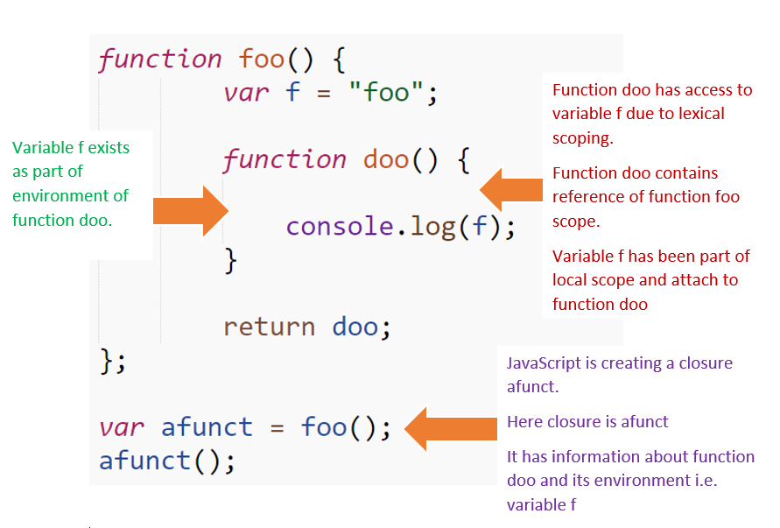
Closures
A closure is a function that "remembers" the variables from its outer scope, even after that scope has exited.
It allows you to create private variables, maintain state between function calls, and write cleaner, modular code.

Slide 3
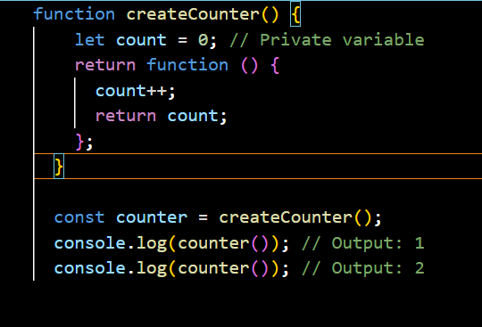
Closures
Here, the inner function retains access to count, even though createCounter has finished executing.
Closures are often used to create module patterns or functions like setTimeout.
Closures demonstrate how JavaScript handles scope and memory.

Slide 4
Functions as First-Class Citizens
n JavaScript, functions are treated as values. This means you can:
Store functions in variables.
Pass them as arguments to other functions.
Return them from functions.

Slide 5
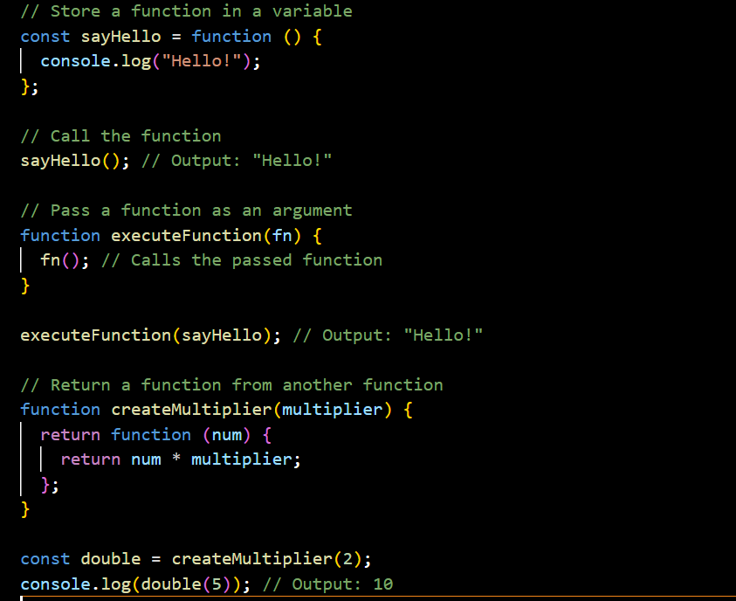
Functions as First-Class Citizens
It makes JavaScript a dynamic and flexible language
Enables powerful patterns like callbacks and higher-order functions

Slide 6
Thank you very much!
www.reallygreatsite.com

